Slide 1
Isle of Manhattan
May 27th – May 30th, 2019

Slide 2
Why Do I Travel?
About Mr. Hicks
{insert photo & bio}
Why I chose this tour
Insert Photo of Yourself
the experience is everything

Slide 3
Why Should You Travel?
The Experience is Everything
Educational travel is a vital part of a
complete education. It expands views,
promotes understanding, and provides
first-hand experiences of classroom
lessons.
The majority of individuals that participated
in youth travel directly credit their travel
experiences as positively impacting their
education and career.
the experience is everything

Slide 4
Highlights of What We’ll See
Grand Central Station
Radio City Music Hall
Broadway Show
Central Park

Slide 5
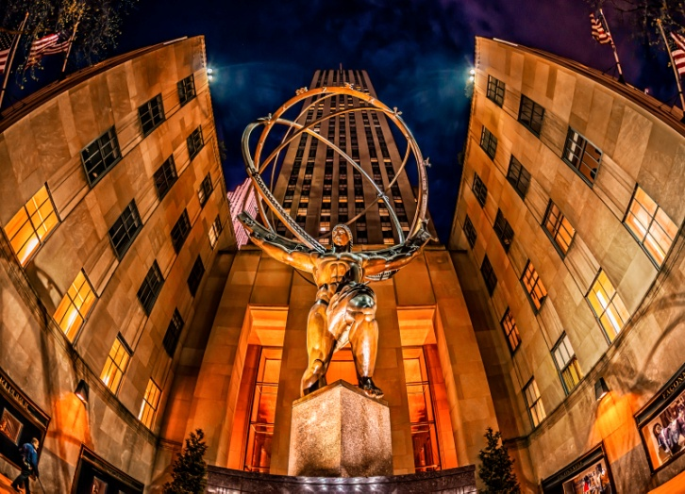
Tour Itinerary
Day 1 Hello New York
Meet your tour director
Midtown guided sightseeing: Rockefeller Center, St. Patrick's Cathedral, Times Square, Grand Central Terminal
Dinner
Top of the Rock visit
Day 2 MoMA & Guggenheim
Breakfast
MoMA visit
Guggenheim Museum visit
Dinner
Broadway show
the experience is everything

Slide 6
Tour Itinerary
Day 3 The MET & Central Park
Breakfast
Broadway workshop
Metropolitan Museum of Art visit
Central Park walking tour: Cherry Hill, Strawberry Fields, Belvedere Castle, Delacorte Theater
Dinner
Broadway show
Day 4 Goodbye New York
Breakfast
Whitney Museum of American Art
Travel home
the experience is everything
Notes:
Day 4 New York CityBreakfast
United Nations visit
MoMA visit
Dinner
Day 5 New York CityBreakfast
American Museum of Natural History and Hayden Planetarium visit
Travel home

Slide 7
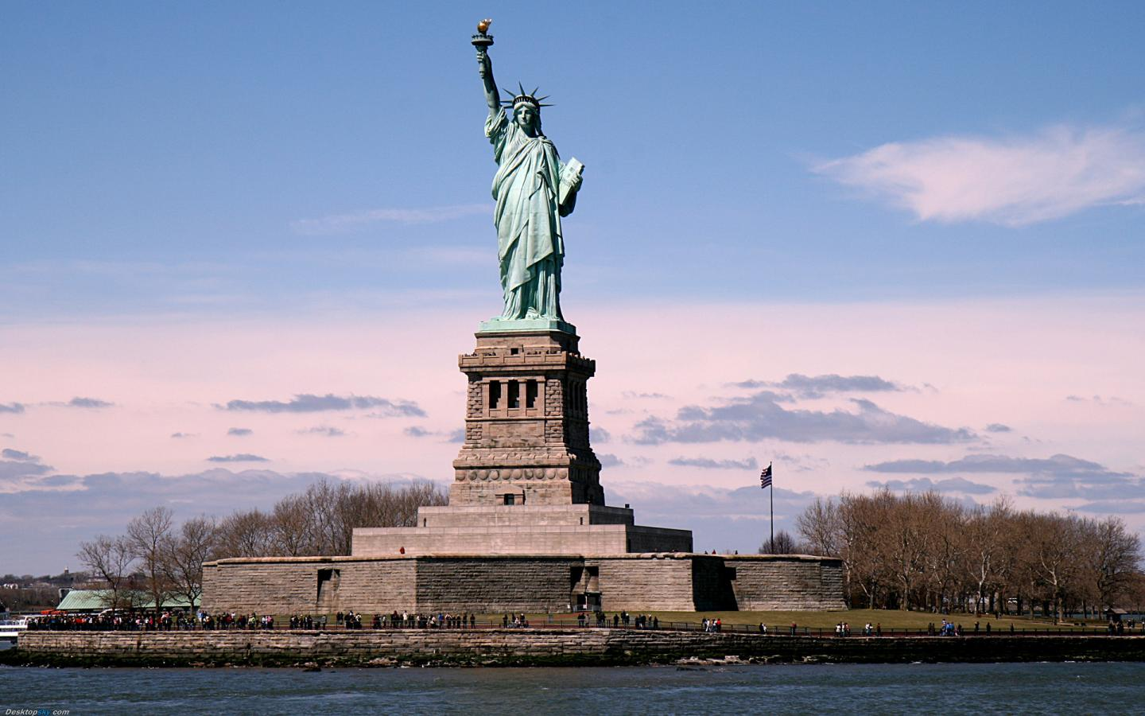
What’s Included?
Round-trip airfare
Airport transfers
3 overnight stays in hotels with private bathrooms
Manhattan Hotel Property
Breakfast daily (except arrival day)
Dinner daily (except departure day)
Full-time services of a professional Tour Director
Guided sightseeing tours and city walks as per itinerary
Visits to select attractions as per itinerary
Subway package
Overnight security chaperone
Tour Diary™
Note: Tour cost does not include airline-imposed baggage fees, or fees for any required passport or visa. Please visit our Fees FAQ page for a full list of items that may not be included in the cost of your tour.
the experience is everything

Slide 8
Travel With Confidence
Travel Protection
4 out of 5 Explorica travelers protect their tours with the travel protection plan.
Travel Protection Plan
$12 per day (up to a maximum of $180).
Must be purchased by your last payment.
Travel Protection Plan Plus
$18 per day (up to a maximum of $270).
Must be purchased within 14 days of enrollment.
Questions: Call Tripmate 800-888-7292 Plan # F433E
To learn more about cancel for any reason and other benefits,
go online: http://www.explorica.com/Resources/Travel-Protection-Plan.aspx
the experience is everything
Notes:
Details on Trip Mate
A traveler’s injury, sickness, or death of an immediate family member.
Theft of passport or visas.
Flight cancellations or trip interruptions due to covered reasons such as sickness, injury, or death.
Trip cancellation or trip interruption due to terrorist acts
Explorica’s Travel Protection Plan PLUS includes “Cancel For Any Reason Benefit”
Allows travelers to cancel their tour for any reason up to two days before departure and receive most of their tour fee back in cash. That means recent events such as the Ash Cloud and the H1N1 outbreak were covered under our plan.

Slide 9
Travel Protection Details
Explorica’s Travel Protection Plan covers you for:
A traveler’s injury, sickness, or death of a family member.
Loss of passport or visas.
Flight cancellations due to strike or bad weather.
Loss of luggage and personal effects.
Trip Cancellation or Trip Interruption due to covered reasons such as a covered sickness, illness, injury or death.
Trip Cancellation or Trip Interruption due to defined Terrorist Acts.
Explorica’s Travel Protection Plan Plus covers you for:
Same benefits as standard plan PLUS Cancel for Any Reason Waiver Benefit.
With the Cancel for Any Reason Waiver Benefit, if you cancel your trip for any reason not otherwise covered by this policy, TripMate will reimburse you for 75% of the non-refundable cancellation fees which apply to your trip.
Please see Terms & Conditions for complete information regarding Travel Protection Plans.
the experience is everything
Notes:
Details on Trip Mate
A traveler’s injury, sickness, or death of an immediate family member.
Theft of passport or visas.
Flight cancellations or trip interruptions due to covered reasons such as sickness, injury, or death.
Trip cancellation or trip interruption due to terrorist acts
Explorica’s Travel Protection PLUS includes “Cancel For Any Reason Benefit”
Allows travelers to cancel their tour for any reason up to two days before departure and receive most of their tour fee back in cash. That means recent events such as the Ash Cloud and the H1N1 outbreak were covered under our plan.

Slide 10
Pricing Details
See detailed pricing at: http://www.explorica.com/Hicks-4684
Total Student Cost: $1,906*
Adults (23+) add $180
*Have you traveled with Explorica before? Then take an additional $50 off the tour cost!
the experience is everything

Slide 11
Payment Options
Automatic Monthly Payment Plans
$50 deposit and any selected travel protection costs at registration.
Balance is divided into equal monthly payments.
All payments billed automatically to credit card or checking account.
Manual Payment Plan – 3 step
Payments are divided into three timed steps:
$99 deposit and any selected travel protection costs at registration.
$300 due 30 days later
Full balance is due 95 days prior to departure.
Manual Payments by check or credit card.
Pay in Full
Entire balance paid upon registration
Payments by check or credit card
the experience is everything

Slide 12
Enrolling Online is Easy
Visit www.explorica.com
Find the “Students: Sign Up” button and then click to go to the next page
the experience is everything

Slide 13
Enter the Tour Center ID
Hicks-4684
the experience is everything

Slide 14
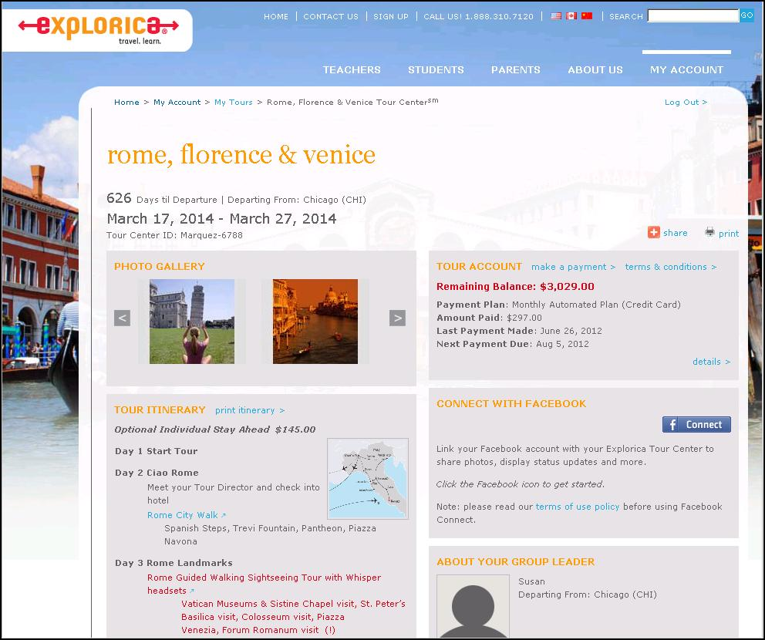
Easy Online Payments
the experience is everything
Notes:
Travelers get their own individual Explorica accounts with username and passwords. The search engine let’s you find quick and easy answers to your questions. Everything you could need is online.

Slide 15
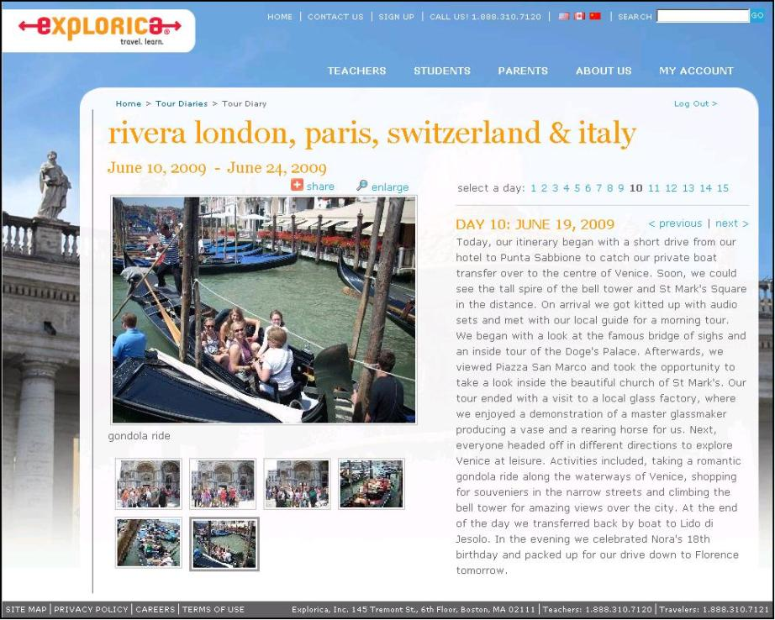
Online Tour Diary
Watch your travelers on tour day by day. Share your tour diary with friends & family!
the experience is everything

Slide 16
What’s it Like Being on Tour?
Watch this video!
the experience is everything

Slide 17
Contact Explorica
Email
info@explorica.com
Mail
Explorica, Inc. 145 Tremont St., Fl. 6 Boston, MA 02111
Fax
1.888.310.7088
Phone
1.888.310.7121
the experience is everything

Slide 18
Questions?

